Slide 1







MegaSoft IT Consulting & Training
ONLINE AUCTION PROJECT
By: Youssef Ahmed

Slide 2

Did you ever have a disposal cost of assets ?

Slide 3
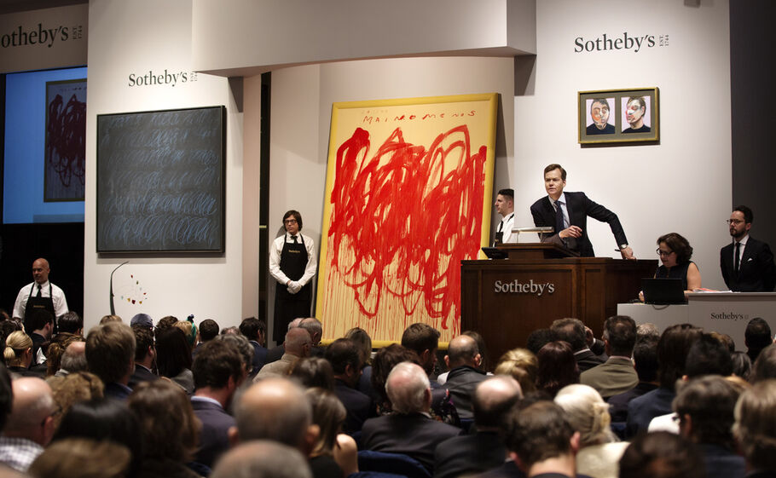
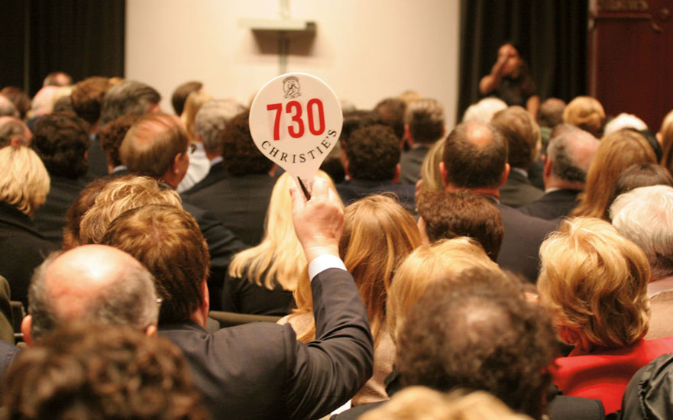
TRADITIONAL AUCTIONS
Limited reach
High costs
Inflexible timeframes
Limited inventory
Limited data for decision making
Time and effort required

Slide 4
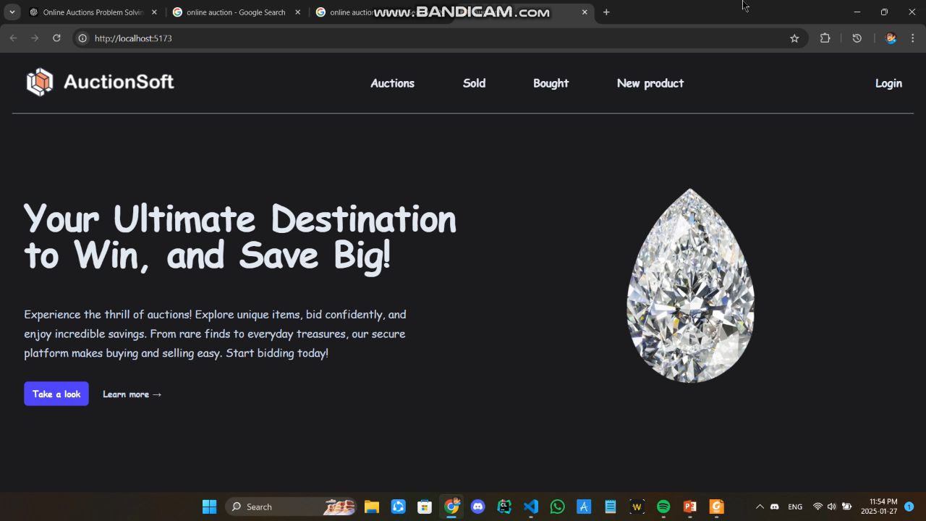
ONLINE AUCTION

Slide 5
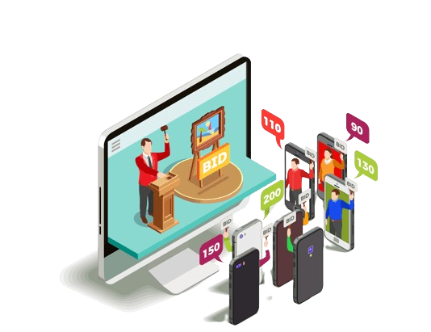
ONLINE AUCTIONS
Global reach
Low costs
Large inventory and variety
Data and analytics
Simplified processes
Bid when you have time !

Slide 6
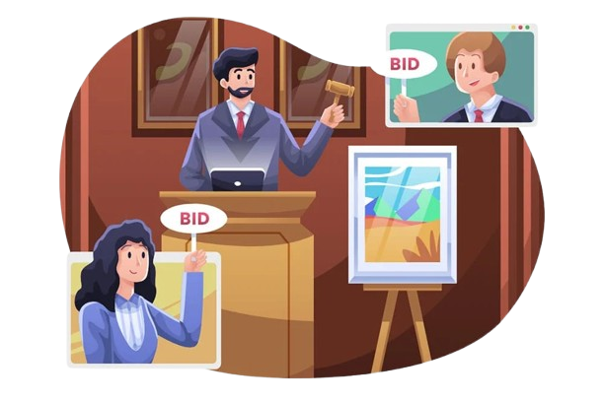
THE APPROACH
The website allows the user to list a product for auction, enabling others to place competitive bids. Bidding continues until the auction's set time ends, with the highest bid securing the item. Once the auction closes, the seller and the winning bidder can get each other’s communication details to complete the deal.

Slide 7
CHALLENGES

Slide 8
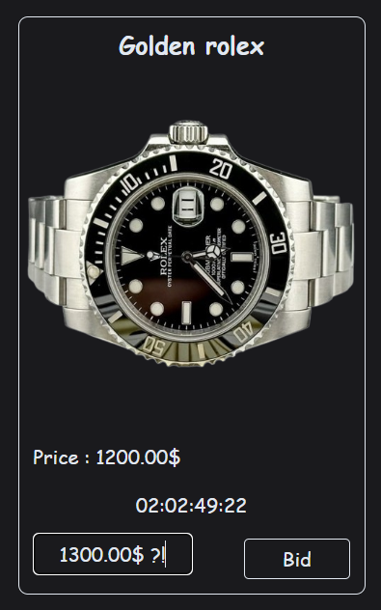
Outdated Price ?
One of the challenges is that when a user attempts to place a higher bid on a product but receives an error stating “he must bid with a higher amount”. This occurs because another user has already bade on the product, causing the price to update. However, the new price is not immediately rendered on other user interfaces, leading to confusion as the displayed price remains outdated.

Slide 9
Solution

Slide 10

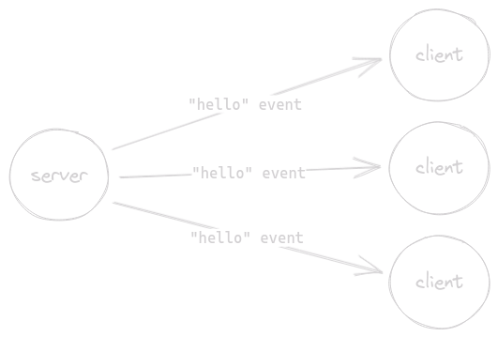
The WebSocket API (WebSockets)
The WebSocket API makes it possible to open a two-way interactive communication session between the user's browser and a server. With this API, any updates will be instantly pushed from the server to all connected clients. This ensures that all users see the latest bid price without needing to refresh their pages.

Slide 11

megasoft
THANK YOU
MegaSoft IT Consulting & Training
By: Youssef Ahmed
Social accounts:
GitHub : https://github.com/Yusef-Ahmed
LinkedIn : https://www.linkedin.com/in/yussif-ahmed/
CodeForces: https://codeforces.com/profile/TANJIR0U

